Slide 1

GRADUATION PROJECT
Digital Lifestyle & Mental Health Analytics
Turning digital-behavior survey data into mental-health risk insights through Python, a Star Schema data model, and an interactive Power BI dashboard
Presented by:
Ahmed Hassan - Hamza Bayoumi - Khlood Ahmed- Malak Tamer - Salma Mohamed - Istabraq El Gendy
Supervised by:
Eng. Mohamed Emam
11/07/2026

Slide 2
Project Idea
The Problem
The Solution
Unique Value
Rising smartphone and social media use is widely linked to worsening mental health, yet which specific digital behaviors most strongly drive depression, anxiety and stress remains unclear across demographic groups.
An end-to-end analytics workflow: clean and model the 100,000-respondent Digital Lifestyle Benchmark Dataset with Python and a Star Schema, then surface findings through an interactive 11-page Power BI dashboard.
A validated, zero-missing / zero-duplicate dataset with engineered risk features that flags the 20.1% of respondents at high risk and translates findings into actionable digital-wellness recommendations.
11/07/2026

Slide 3
Project Wireframes
Dashboard Pages
Executive Summary
Demographics
Device Usage
Social Media
Sleep Analytics
Mental Health
01
02
03
04
05
06
Productivity
High Risk Users
Physical Activity
Correlations
Segmentation
07
08
09
10
11
Dashboard Flow & Storytelling
Overview
→
Behavior
→
Health Impact
→
Risk & Action
The dashboard opens with a high-level Executive Summary, moves into behavioral pages (Device, Social Media, Sleep), then into health outcomes (Mental Health, Productivity), and closes with Risk & Segmentation pages that drive action.
11/07/2026

Slide 4
End Users & Features
Primary End Users
Key Features
Researchers
Dashboard:
12-page interactive Power BI report covering behavior, sleep & mental health
Explore patterns behind digital-related mental health risk.
Healthcare Professionals
KPIs:
Real-time cards for device hours, unlocks, notifications & risk %
Use risk indicators to inform screening and early intervention guidance.
Segmentation:
Grouping by demographics, income, education, occupation & device type
Students
Reflect on personal screen-time habits and their link to sleep, focus & mood.
Correlation Analysis:
Quantifies links between screen time, sleep & depression scores
Individuals
Benchmark personal digital habits against population-level norms.
Filtering:
Dynamic slicers for age, gender, region & risk band across all pages
Organizations
Risk Detection:
Flags the 20.1% of respondents in the high-risk band for follow-up
Apply findings to shape digital-wellness policies and awareness programs.
11/07/2026

Slide 5
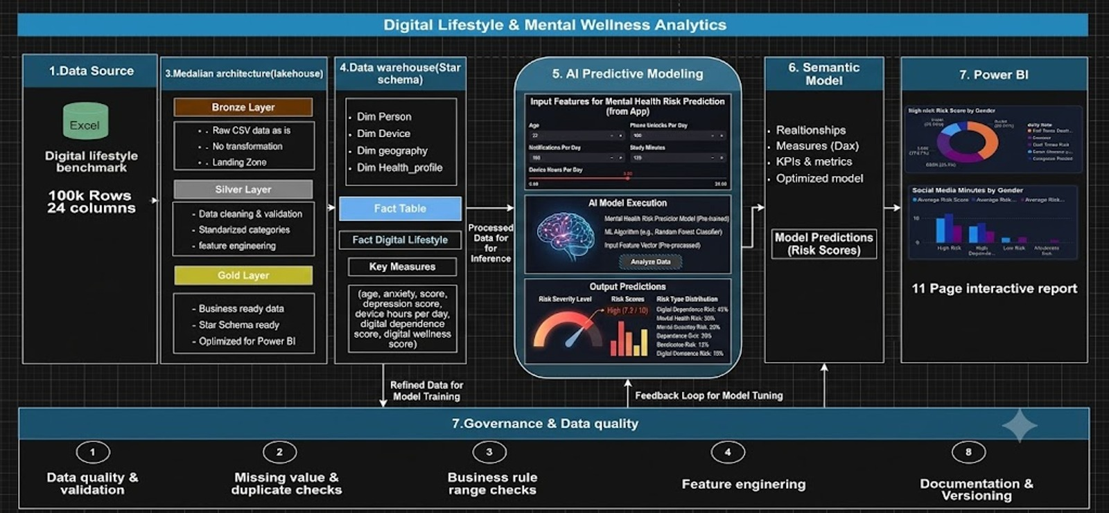
Technical Architecture
11/07/2026

Slide 6
Data Structure
Medallion Architecture: Data Flow
dim_person
BRONZE
File: digital_lifestyle_benchmark_2025.csv
CSV, 100,000 rows × 24 cols, unprocessed as-collected data
dim_device
fact_digital_
lifestyle
dim_geography
▼
SILVER
File: cleaned_digital_lifestyle_data.csv
Validated & standardized, 7 new analytical columns added
dim_health_profile
▼
GOLD
Fact Table Key Measures
Tables: fact_digital_lifestyle + 4 dims
age · depression_score · anxiety_score · device_hours_per_day · digital_dependence_score · digital_wellness_score
Star Schema, DAX measures, Power BI ready
11/07/2026

Slide 7
Programming Languages and Framework
Programming Languages
Cloud & Platforms
• Microsoft Excel: data preparation & querying
• Python: primary language for data cleaning and analysis
• Power BI: 11-page interactive dashboard
• Google Colab: python development environment
• DAX: Power BI KPI calculations and measures
• Hugging Face: dataset source
• Figma: Dashboards design
Frameworks & Libraries
Data & Delivery Formats
• Pandas: data cleaning & manipulation
• CSV: Gold layer storage
• NumPy: numerical computations
• PBIX: final Power BI dashboard file
• Matplotlib: exploratory data visualization
• Star Schema: fact + 4-dimension tables
• Scikit-learn: predictive risk modeling
• Direct Power BI: Excel/CSV integration
11/07/2026

Slide 8



Live Application + Test
Live Application Status
Testing & Validation
PRODUCTION-READY
11-page Power BI dashboard built on the Gold-layer star schema, first prototyped in Figma.
✓ Data Validation
Zero missing values detected across all 100,000 rows
Key Testing Phases
✓ Missing Value Check
isnull().sum() confirmed — all 24 columns fully populated
1. Data & Business-Rule Validation
✓ Duplicate Check
100,000 rows × 24 columns checked for missing values, duplicates & valid ranges (age 10–100, sleep 0–24h, activity 0–7 days)
id.duplicated() confirmed — zero duplicate records found
2. Model Integration Testing
✓ Business Rule Validation
Gold-layer fact & dimension tables (star schema) integrated and validated inside the Power BI data model
Age 10–100 · Sleep 0–24h · Activity 0–7 days enforced
✓ KPI Verification
3. Dashboard & KPI Testing
Dashboard totals cross-checked against Gold-layer aggregates
All 11 pages and KPI cards verified against Gold-layer aggregates before publishing
✓ Dashboard Testing
All 12 pages tested: slicers, cross-filter & visual consistency
11/07/2026

Slide 9
Key Insights: Behavior and Correlations
💡 Key Finding: Device usage hours show the strongest link to depression scores (r = 0.80), stronger than any single demographic factor.
Behavioral Correlations
Population Mental Health Snapshot
Device hours vs depression: r = 0.80 (strongest predictor)
Digital dependence vs depression: r = 0.71
Notifications vs focus score: r = -0.70
Sleep hours vs depression: r = -0.48 (protective effect)
Stress score drops steadily as sleep increases (7.0 → 4.1 across sleep bands)
Average anxiety score: 7.2 / 10
Average depression level: 8.8 / 10 — highest of all wellness indicators
Average happiness score: 6.4 / 10
Average stress level: 5.08 / 10
Average digital dependence score: 36.7 / 100
11/07/2026

Slide 10
Key Insights: High Risk and Recommendations
High Risk Users
Avg Device Hours
Avg Anxiety Score
Avg Social Media Minutes
20,066
7.33 hrs/day
7.2 / 10
156.1 mins
20.1% of total population
High-risk group average
High-risk group average
High-risk group average
Risk Factor Impact
Actionable Recommendations
Device hours is the strongest single predictor of depression (r = 0.80)
Sleep duration shows a protective, inverse relationship with depression (r = -0.48)
High-risk users average 7.33 device hours/day, slightly above the 7.3-hour population average
High-risk users report 156.1 social media minutes/day, in line with the population average
Set screen-time and notification limits for heavy device users
Promote sleep-hygiene programs given sleep's protective link to depression
Prioritize the High Dependence segment for targeted wellness interventions
Integrate the ML risk model into early-screening workflows
Track focus and stress scores as early-warning indicators alongside anxiety/depression
11/07/2026

Slide 11
Machine Learning Model
✓ Best Model: Logistic Regression
Model Performance
Logistic Regression:
Accuracy: 66.59%
F1 Score: 44.13%
Random Forest:
Accuracy: 79.15%
F1 Score: 13.64%
XGBoost:
Accuracy: 67.82%
F1 Score: 43.19%
Pipeline & Process
Deployment & Results
• Developed an end-to-end ML pipeline to predict Mental Health Risk
• Deployed using Streamlit for real-time interactive prediction
• Performed data preprocessing and feature selection on the Gold-layer dataset
• Users input digital habits and receive an instant mental health risk score
• Trained and compared: Logistic Regression, Random Forest, and XGBoost
• Model performance verified on held-out test split
• Integrated as an additional deliverable alongside the Power BI dashboard
• Selected Logistic Regression as the best-performing model
11/07/2026

Slide 12
Deliverables
01
02
03
Clean Dataset
Python Notebooks
Power BI Dashboard
Silver-layer CSV
100,000 rows × 31 cols
Bronze · Silver · Gold
Colab pipeline
11-page .pbix file
Star Schema model
04
05
06
Documentation
Presentation
PBIX File
Full project report
architecture & pipeline
Slide deck covering
all project phases
Power BI file with
DAX measures & pages
11/07/2026

Slide 13
Project Team & Roles
Khlood Ahmed
Salma Mohamed
Malak Tamer
Istabraq el gendy
Project Lead &Documentation & QA& Figma & Presentation
BI Developer
Documentation & QA& Figma & Presentation
BI Developer
Hamza Bayoumi
Ahmed Hasan
Data Engineer
Data Engineer
Collaboration Methods
[Communication tool — e.g., Microsoft Teams / Google meet]
[Version control — e.g., GitHub / Google Drive]
11/07/2026
8

Slide 14
Thank You
Questions & feedback are welcome
11/07/2026

